Slide 1
2020 AP Exams Updates for Schools Affected by COVID-19
Edward Biedermann, Executive Director Advanced Placement Program
April 13, 2020

Slide 2
Contents
01
About This Year’s AP Exams
02
At-Home Testing
03
Instructional Supports
04
Students, Teachers, and Coordinators
05
Important Dates
06
Q&A

Slide 3
About This Year’s AP Exams
The health and safety of educators and students is the AP® Program’s highest priority.
As schools and communities navigate the challenges posed by the coronavirus (COVID-19) outbreak, we will support AP students with free, optional virtual learning and at-home AP testing. These resources will give students the opportunity to earn the college credit and placement they’ve been working toward all year.
Students remain eager to take AP Exams. We reached out to 18,000 AP students and they overwhelmingly indicated they want to complete this important step.
We’re confident that the vast majority of Higher Ed institutions will award credit as they have in the past. We’ve spoken with hundreds of institutions across the country who support our solution for this year’s AP Exams.
The AP Program will invest heavily in solutions that are designed to be as simple and lightweight as possible for both students and teachers—and avoid creating an additional burden for school leaders during this difficult time.

Slide 4
At-Home Testing
For the 2020 AP Exam administration only, we developed secure, online free-response exams for each course.
The exam content will only include topics and skills most AP teachers and students have already covered in class by early March.
Students will be able to take these streamlined exams on any device they have access to—computer, tablet, or smartphone. Taking a photo of handwritten work will also be an option.
Like many college-level exams, this year’s AP Exams will be open book/open note.
These streamlined digital exams will not require any test booklet shipments, external proctors, or any additional workload for schools.
For course-specific AP Exam Information, please visit http://cb.org/apschedule2020

Slide 5
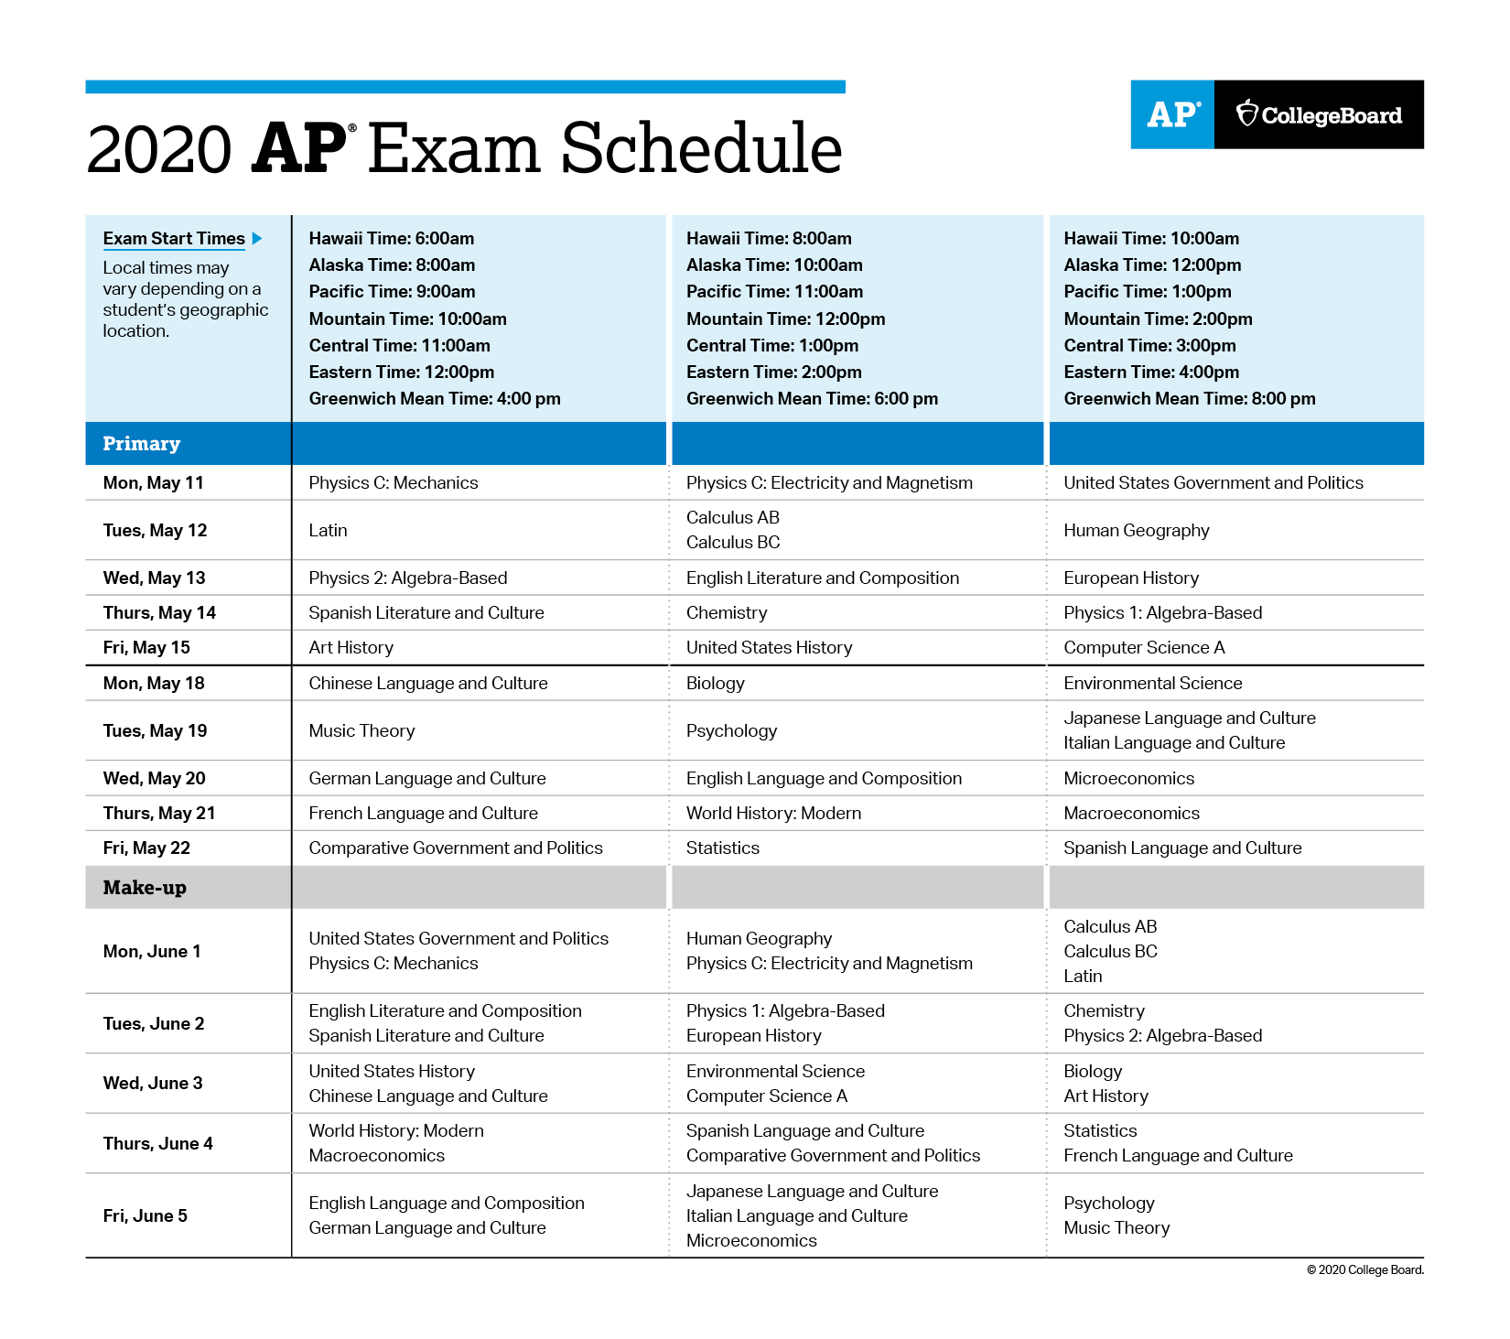
Each subject’s exam will be taken on the same day at the same time, worldwide (i.e., simultaneously).
To see this year’s AP Exam schedule and course-specific information:
https://apcoronavirusupdates.collegeboard.org/educators/taking-the-exams/ap-exam-schedule

Slide 6
Additional details about format, scores, and security
Exam Format
Exam Scores
Exam Security
For most subjects, the exams will be 45 minutes, plus an additional 5 minutes for uploading. Students will need to access the online testing system 30 minutes early to get set up.
2-D Art and Design, 3-D Art and Design, Drawing, Computer Science Principles, Research, and Seminar will use portfolio submissions and will not have a separate online exam. All deadlines for these submissions have been extended to May 26, 2020 at 11:59 p.m. ET.
Students taking world language and culture exams will complete two spoken tasks consistent with free-response questions 3 and 4 on the current AP Exam. Written responses will not be required.
We'll provide more details in the coming weeks to help students prepare.
As usual, students’ work will be scored by college faculty and AP teachers, and will be reported on 1–5 scale.
We anticipate releasing scores as close to the usual July timeframe as possible.
The exam format and questions are being designed specifically for an at-home administration, so points will not be earned from content that can be found in textbooks or online.
Students may not consult with any other individuals during the testing period.
A comprehensive and strict set of protocols are in place to prevent and detect cheating, and details will not be shared prior to exams.
Students attempting to gain an unfair advantage will either be blocked from testing or their AP scores will be canceled, their high school will be notified as will colleges or other organizations to which they have already sent any College Board scores, including SAT scores. Student may be prohibited from taking a future Advanced Placement Exam as well as the SAT, SAT Subject Tests, or CLEP assessments.

Slide 7
Online AP Classes and Review
Free, Live AP Review Lessons
Students and teachers now have access to free, live AP review lessons, delivered by AP teachers from across the country. These optional, mobile-friendly classes are designed to be used alongside work that may be given by schools.
These classes are available on-demand, so teachers and students can access them at any time.
These on-line classes are not dependent on current AP teachers continuing instruction. We know many AP teachers now face challenges that would make that impossible.
The lessons enable students to complete the few remaining topics of each AP class, and then focus on reviewing the skills and concepts from the first 75% of the course.
AP Classroom Resources
Teachers who are already providing remote instruction can continue to leverage AP Classroom, introduced at the start of the school year.
Within AP Classroom, free-response questions that were only available for in-classroom use due to security concerns will now be unlocked.
Teachers will be able to assign questions to students digitally.
Starting April 13, students will see a new Optional Student Practice section that includes the most relevant FRQs to help them practice the concepts and skills that will be tested in May 2020. They can answer these in any order and will have an opportunity to review how each question will be scored before they submit.

Slide 8
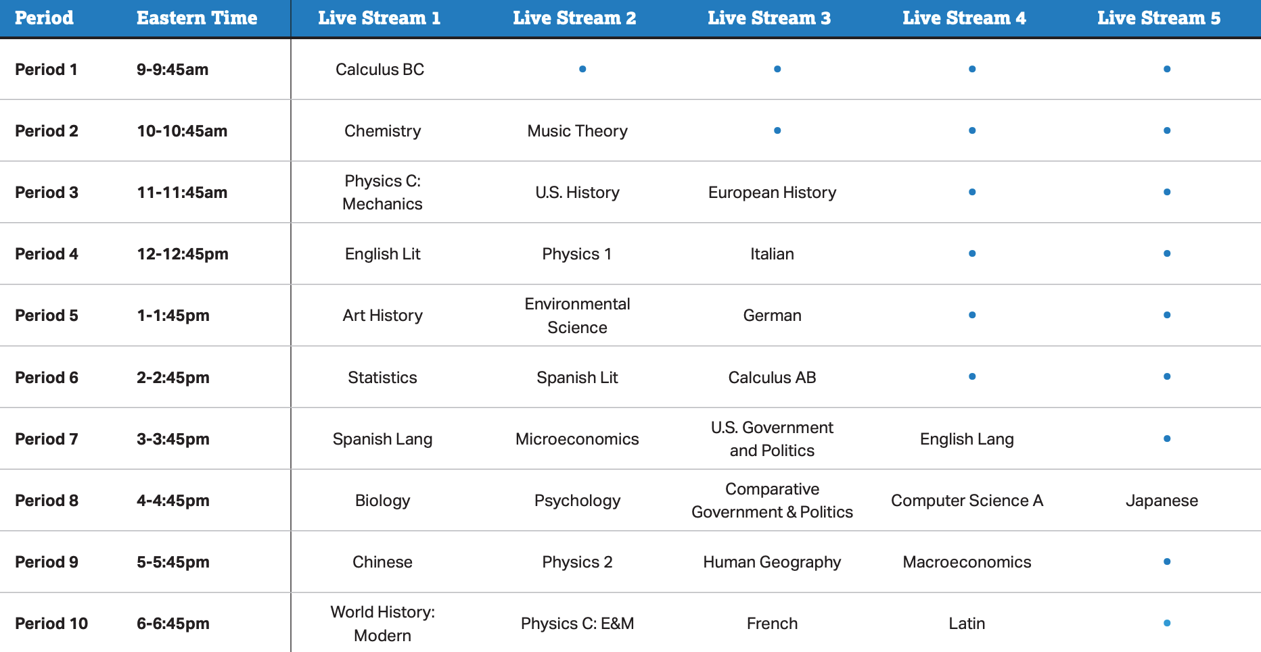
Online AP Classes and Review
To access the live classes and recordings, please visit:
youtube.com/advancedplacement
Daily Course Schedule – All times are Eastern Time.

Slide 9
What Should AP Students Know and Do?
Taking AP Exams
AP Exams have been revised to about 45 minutes each and will be taken online, at home.
AP Exams are scheduled for May 11-22, with make-up testing on June 1-5. We strongly encourage students to take their AP Exams during the main testing window.
This year’s exams focus on content most teachers covered prior to March. So this year’s exams have been designed to honor and reward the good work students already did prior to widespread school closures.
Colleges across the country are voicing strong support for students to complete the AP experience, take the exam, and receive the college credit they deserve. Colleges are especially supportive given the uncertain financial future many families face, and the value of students entering college with credit.
Depending on a school’s exam-taking policy, a student can opt-out of the exam if they prefer not to test this year; there will not be a $40 cancellation fee.
Students who need help with access to a device or internet can let us know by April 24.
Preparing for AP Exams
On AP Central, students can see course-specific exam information, including exam dates and times, descriptions of what they’ll be asked to do on their exam, tips for open book/open note test taking and more; exam features; exam scoring; and exam security.
On YouTube, students can access daily, online AP classes and review at https://youtube.com/advancedplacement
Students can view the 2020 AP Exam updates and prepare for AP Exams.

Slide 10
What Can AP Teachers Do?
Share Course-Specific Exam Information: Teachers and students can view course-specific exam information by visiting AP Central, so students feel more prepared.
Use Online AP Classes and Review: Teachers that are continuing instruction can consider incorporating new online video lessons delivered each weekday by fellow AP teachers from across the country.
These optional, mobile-friendly classes will review the AP content and skills typically taught by early March and are designed to be used alongside work that may be given by schools. There will also be some supplementary lessons covering the remainder of the course.
Syllabi and schedule for the new online video AP lessons are available at http://cb.org/coronavirusAP
Lessons for Art and Design, CSP, Seminar, and Research are now available on-demand. Additional lessons will be posted on April 6, 8, and 13.
Use AP Classroom: Teachers can also use the free resources at AP Classroom to check students’ understanding of key content and skills. See the one-page guide at for more information about how AP Classroom can help support student learning during school closure.
Teachers are not required to do any new tasks related to AP instruction and testing.

Slide 11
What Should AP Coordinators Do?
Share information: AP coordinators who are able can help by letting students know that they’ll be able to take AP Exams this year, even if they’re at home. It won’t matter if students are currently registered for regular or late testing, so long as they’re registered for an exam. AP Registration and Ordering will automatically mark any unused exams.
Coordinators who plan to actively manage the exam administration process can do the following: communicate the importance of taking the exam to students and parents, help students identify exam conflicts, and remind students about exam dates and requirements. Some schools are planning to put in place a ‘check-in’ process to communicate with their students immediately before the exam to confirm students are ready to test.
Indicate fee reduction eligibility: Coordinators need to indicate a student’s fee reduction eligibility in AP Registration and Ordering as soon as possible, particularly in states with early state funding deadlines —this will help ensure that the school is billed correctly. To provide AP coordinators with additional flexibility, we’ve extended the deadline to May 26, 11:59 p.m. ET.
Remit payment: The deadline for schools to remit payment to the College Board for AP Exams has been extended to Friday, June 26. Schools that will have difficulty meeting this deadline because of extended closure should contact AP Services for Educators. Note: we will not charge schools the $225 late payment fee in 2020.
If schools remain closed, AP coordinators who haven’t collected exam fees have the option to arrange a payment partner through which students can make payments. Coordinators can visit our payment providers page for more details.
Ensure portfolio submissions: Coordinators who have students taking an exam with required portfolio submissions (Art and Design: 2D, Art and Design: 3D, Computer Science Principles, Drawing, Research, Seminar) should ensure students have submitted their work as final in the subjects’ respective digital portfolios. The extended deadline for digital portfolio submissions is May 26, 11:59 p.m. ET. No further extensions will be granted.
For more information, please visit apcoronavirusupdates.collegeboard.org/coordinators
Because there will not be any AP paper-and-pencil testing this year, AP coordinators will not need to handle incoming or outgoing shipments, organize test rooms, assign proctors, or any of the tasks associated with running a school-based exam administration.

Slide 12
Important Dates
April 13: New AP Classroom features
We've unlocked relevant free-response questions in AP Classroom for digital use so teachers can assign free-response questions that students can take at home. Starting April 13, students, including students in exam-only sections, will see a new Optional Student Practice section that includes the most relevant free-response questions (FRQs) to help them practice the concepts and skills that will be tested in May 2020. Students can answer these in any order, and they'll have an opportunity to review how each question will be scored before they submit so they can review and revise their answer.
By April 20, 11:59 p.m. ET: Switching exams for AP Calculus
We are allowing students to switch from Calculus BC to Calculus AB and vice versa at no charge. AP coordinators must call AP Services for Educators to unlock their order. The deadline to make this change is Monday, April 20, 11:59 p.m. ET. Please, see the AP Coordinator’s Manual, Part 1 for guidance.
By April 24: Confronting the digital divide
We recognize that some students may not have access to the tools and connectivity they need to review AP content online and take the exam. If your students need mobile tools or connectivity, you can reach out to us directly to let us know by April 24 at https://collegeboard.tfaforms.net/74.
May 11-22: 2020 AP Exam dates
Exams will be given May 11-15 and May 18-22.
.
By May 26, 11:59 p.m. ET: Fee reduction eligibility
Coordinators should indicate student’s fee reduction eligibility in AP Registration and Ordering as soon as possible, particularly in states with early state funding deadlines—this will help ensure that the school is billed correctly. To provide AP coordinators with additional flexibility, we’ve extended the deadline to May 26.
By May 26, 11:59 p.m. ET: Portfolio submissions
Coordinators who have students taking an exam with required portfolio submissions (Art and Design: 2D, Art and Design: 3D, Computer Science Principles, Drawing, Research, Seminar) should ensure students have submitted their work as final in the subjects’ respective digital portfolios. The extended deadline for digital portfolio submissions is May 26, 11:59 p.m. ET. No further extensions will be granted.
June 1-5: Make-up test dates
Make-up test dates will be available for each subject from June 1-5.
June 26: Payment deadlines
The deadline for schools to remit payment to the College Board for AP Exams has been extended to Friday, June 26. Schools that will have difficulty meeting this deadline because of extended closure should contact AP Services for Educators. Note: we will not charge schools the $225 late payment fee in 2020.

Slide 13
Visit AP Central® for more information
We’ll be updating the website with additional details as we have them.
For more information about our free online AP classes and take-at-home AP Exams for 2020, please visit apcoronavirusupdates.collegeboard.org

Slide 14
Q&A
To view answers to our most frequently-asked questions, visit apcoronavirusupdates.collegeboard.org/faqs

